Slide 1
CrowdTruth
Crowdsourced fact-checking
Tom Lemberg and Will Sun

Slide 2
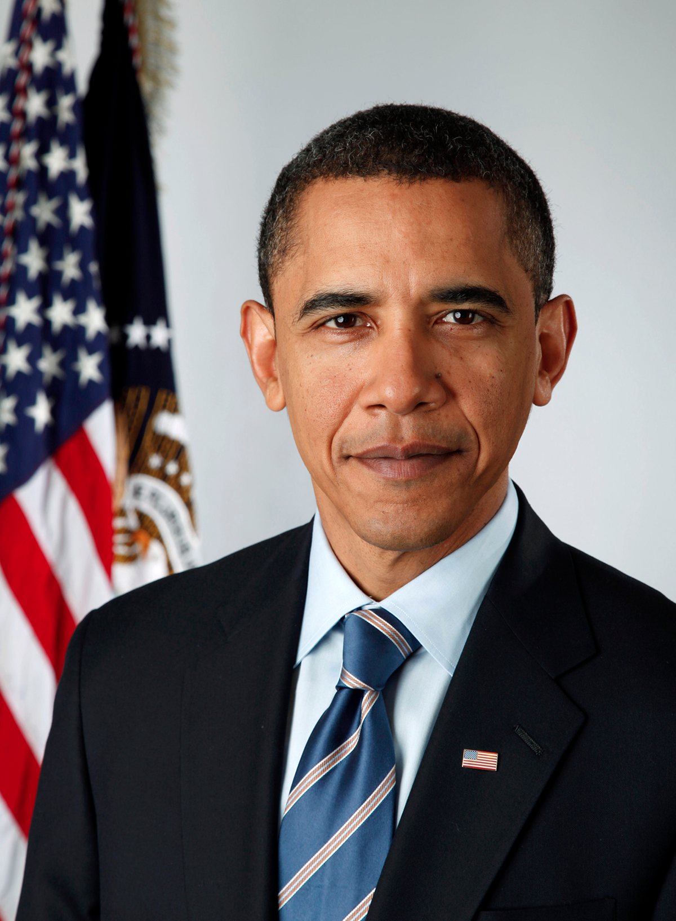
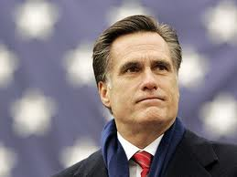
v.

Slide 3
Identify
(3-5 facts)
Verify facts
(3x)
(for each fact, up to 5 facts)
Source
(3x)
Source
(3x)
Source
(3x)
Vote
(3x)
Vote
(3x)
Vote
(3x)
Process

Slide 4
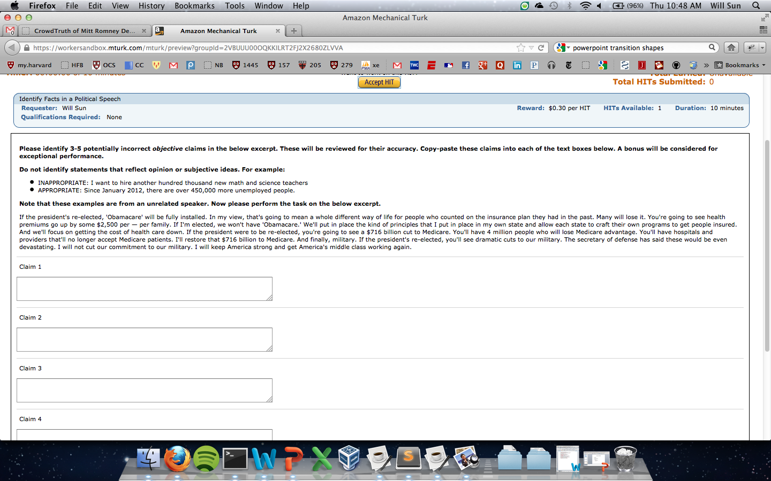

Slide 5
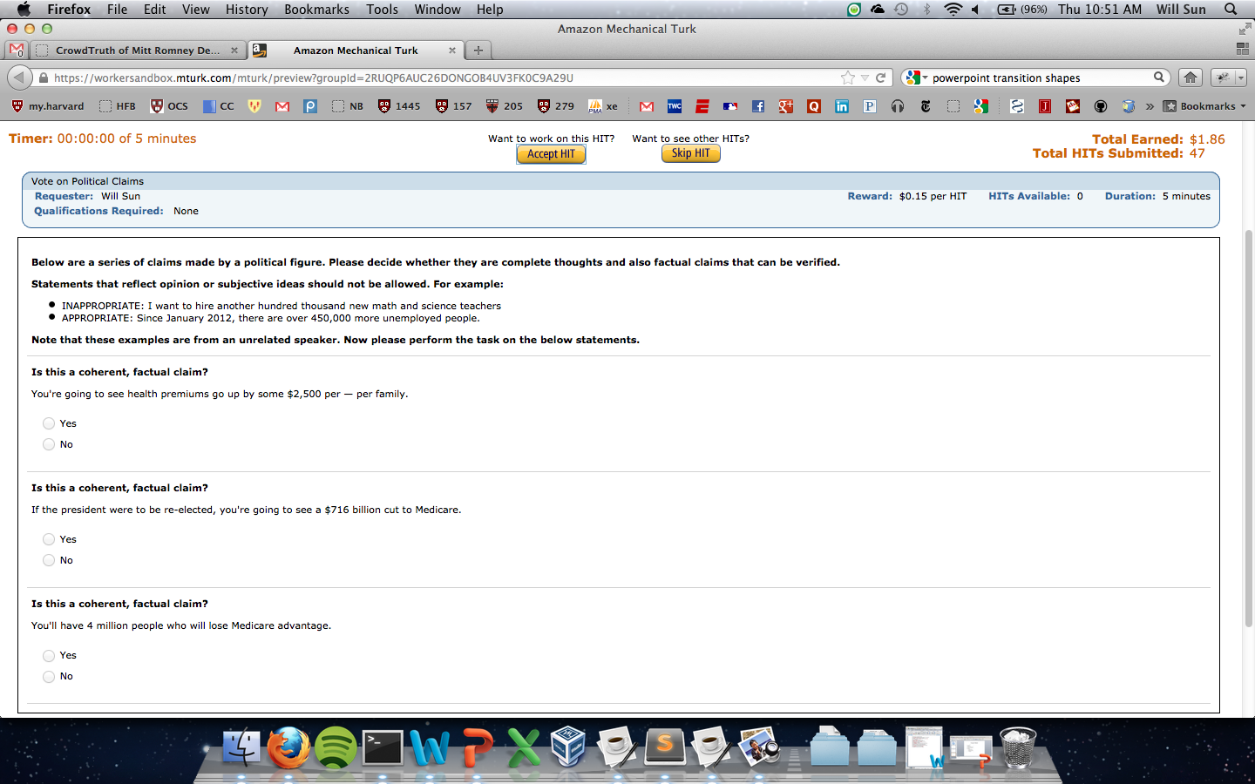

Slide 6
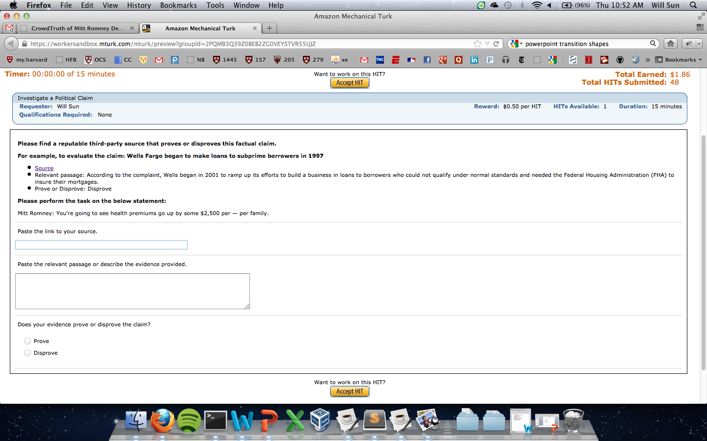

Slide 7
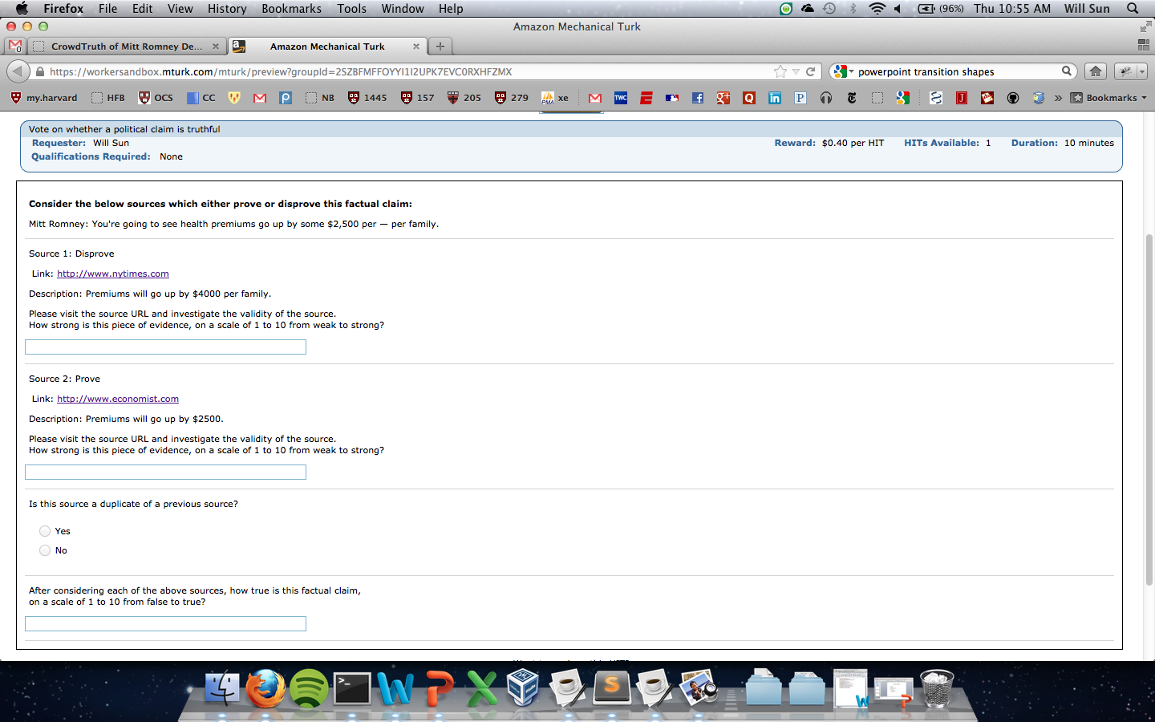

Slide 8
Results

Slide 9
Lessons Learned
Accuracy
Instructions
Threshold
Quantity
Cost
Speed
Secondary sources and cognitive load

Slide 10
Future Work
Iterative?
Partitioning
Improve visualization
Duplicate sources
Workers
Qualifications
Blocking repeats
Feedback

